Slide 1
Freight Invoice Inquiry
Updates & Additional
Information
http://fbaportal.birddog.com/

Slide 2
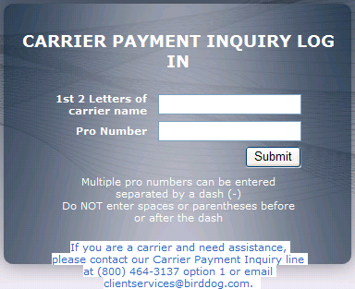
Carrier Payment Inquiry
In order to provide the most efficient access to updates on statuses for processing, and in some cases, payments on invoices, we have created a site that can be accessed 24 hours a day, 7 days a week.
You will need to go to http://fbaportal.birddog.com/
On the Right hand side of the screen, under Carrier Payment Inquiry Log In, you will need to enter the first two letters of the carrier’s name, and then the invoice or pro number.
Please do not enter any spaces or dashes & do include any leading zeros.

Slide 3
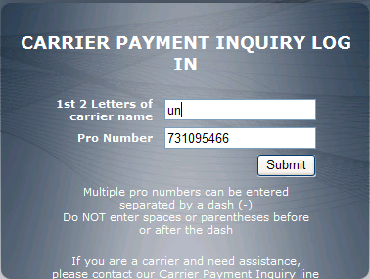
Carrier Payment Inquiry
For example, if the shipping company name is Universal Freight Shippers, for the first two letters, you would enter “un”.
You would then enter the Pro or Invoice number on the second line.
You need to then hit the “Submit” button (hitting the enter key on your keyboard will not work).

Slide 4
Invoice that BirdDog has NOT received for Processing
If BirdDog has never received or processed the invoice in question, and we do not have a copy loaded in our system, you will see the result below. You will then have the option to upload or email in a PDF file that contains the invoice along with the back up documentation needed to process that invoice.

Slide 5
Emailing in an Invoice that BirdDog has NOT received for Processing or Resubmitting an invoice with updated backup.
If you need to submit or re-submit any freight invoices to BirdDog for processing and would like to do so via e-mail for the fastest processing, please follow the guidelines below. When e-mailing, please use the address fbainvoices@birddog.com. Failing to follow these guidelines may result in delayed processing.
Please submit one invoice set, including the requested additional items, per attachment in PDF format. An invoice set is defined as, but not limited to:
Freight Invoice
Bill of Lading, air/sea waybill
Proof of Delivery if required by the shipper
Entry/Immediate Delivery or Entry Summary Documents if applicable
Commercial Invoice
The image must be legible.
All pages should be turned correctly (not sideways or upside down).
Certain shippers require a physical copy of their invoice. In that event, the carrier will be responsible to provide the physical copy directly to the shipper. Accordingly, BirdDog presumes you have the shipper’s authorization to e-mail carrier invoices to us.
The aforementioned procedures allow us to audit and process the invoices within the contractual parameters established. Your assistance is appreciated. Please allow up to 72 hours before having visibility to the status of your invoice, which can be seen at the Payment Inquiry portal http://fbaportal.birddog.com.

Slide 6
Uploading an Invoice that BirdDog has NOT received for Processing or Resubmitting an invoice with updated backup.
If you need to submit or re-submit any freight invoices to BirdDog for processing and would like to do so via uploading it directly for processing, please follow the guidelines below. When uploading, please use the “click here” link. Failing to follow these guidelines may result in delayed processing.
Please submit one invoice set, including the requested additional items, per PDF. An invoice set is defined as, but not limited to:
Freight Invoice
Bill of Lading, air/sea waybill
Proof of Delivery if required by the shipper
Entry/Immediate Delivery or Entry Summary Documents if applicable
Commercial Invoice
The image must be legible.
All pages should be turned correctly (not sideways or upside down).
Certain shippers require a physical copy of their invoice. In that event, the carrier will be responsible to provide the physical copy directly to the shipper. Accordingly, BirdDog presumes you have the shipper’s authorization to e-mail carrier invoices to us.
The aforementioned procedures allow us to audit and process the invoices within the contractual parameters established. Your assistance is appreciated. Please allow up to 72 hours before having visibility to the status of your invoice, which can be seen at the Payment Inquiry portal http://fbaportal.birddog.com.

Slide 7
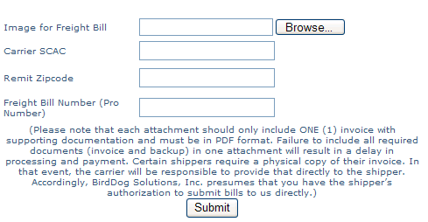
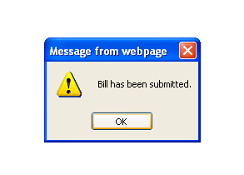
Uploading an Invoice that BirdDog has NOT received for Processing or Resubmitting an invoice with updated backup.
By Clicking on the “click here” link, you will be taken to a page where you will need to upload the PDF, enter your SCAC code, the payment remit zipcode, and the Freight Bill Number. Once complete and the file has been loaded, you will receive the message below with a notice that the Bill has been submitted. If any of these fields do not match what we are expecting for your upload, you will be given an option to “Request Help”.

Slide 8
Invoice that BirdDog HAS received for Processing
If BirdDog has received the invoice in question, you will see the result below. You will have the option to open each instance if we have received more than one copy to process. If there are multiple results, you will want to open each to ensure you have all the details for that invoice.
If you see the information you were looking for on this first page, you may not need to go any further. If additional details are needed as to why an invoice was not paid, payment status, cut down reasons, etc. Then you will need to click on the actual Pro number for additional details.

Slide 9
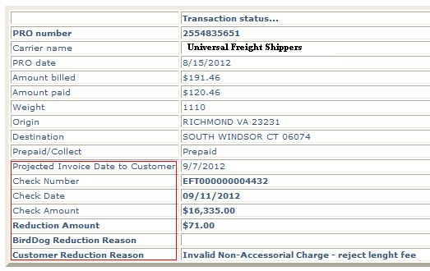
Invoice that BirdDog HAS received for Processing
If you need additional details on a Pro number, click the pro number and you will be taken to a new screen that contains additional fields of details.

Slide 10
If you need additional assistance, please contact our Carrier Payment Inquiry line at (800) 464-3137 option 1
or email clientservices@birddog.com

